Slide 1
MATHEMATICAL FOUNDATION FOR COMPUTER SCIENCE
Prepared by: Er. Ankit Kharel
Nepal college of information technology

Slide 2
GRAPH THEORY

Slide 3
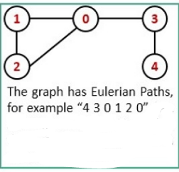
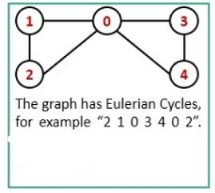
EULER GRAPH:
The Euler path is a trial, by which we can visit every edge of a Graph exactly once. We can use the same vertices for multiple times. The Euler Circuit is a special type of Euler path. When the starting vertex of the Euler path is also connected with the ending vertex of that path, then it is called the Euler Circuit.
2. A graph containing Euler Path is called Euler Graph.

Slide 4
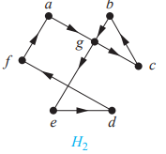
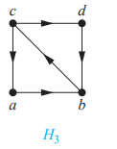
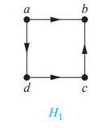
EULER GRAPH:
The graph H2 has an Euler circuit, for example, a, g, c, b, g, e, d, f, a. Neither H1 nor H3 has an Euler circuit (as the reader should verify). H3 has an Euler path, namely, c, a, b, c, d, b, but H1 does not (as the reader should verify).

Slide 5
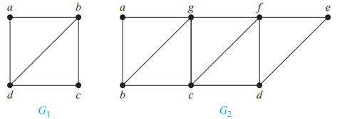
EULER GRAPH:
NECESSARY AND SUFFICIENT CONDITIONS FOR EULER CIRCUITS AND PATHS:
A connected multigraph with at least two vertices has an Euler circuit if and only if each of its vertices has even degree.
A connected multigraph has an Euler path but not an Euler circuit if and only if it has exactly two vertices of odd degree and they are starting and ending point.
G1 contains exactly two vertices of odd degree, namely, b and d. Hence, it has an Euler path that must have b and d as its endpoints. One such Euler path is d, a, b, c, d, b. Similarly, G2 has exactly two vertices of odd degree, namely, b and d. So it has an Euler path that must have b and d as endpoints. One such Euler path is b, a, g, f, e, d, c, g, b, c, f, d

Slide 6
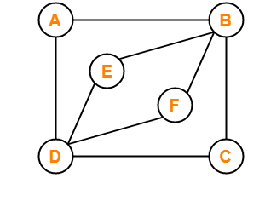
EULER GRAPH:
Since all vertices of above graph has EVEN degree. There is Euler Circuit.
A-B-C-D-F-B-E-D-A

Slide 7
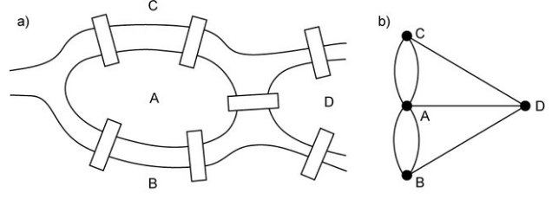
7 BRIDGE OF KÖNIGSBERG:

Slide 8
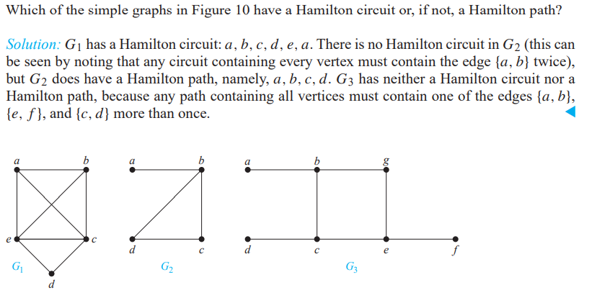
HAMILTON GRAPHS:
A path in a graph G that passes through every vertex exactly once is called a Hamilton path. The Hamilton Circuit is a special type of Hamilton path. When the starting vertex of the Hamilton path is also connected with the ending vertex of that path, then it is called the Hamilton Circuit.

Slide 9
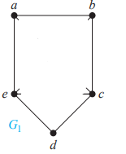
HAMILTON GRAPHS:
:SUFFICIENT CONDITON FOR HAMILTON GRAPH:
ORE’S THEOREM : If G is a simple graph with n vertices with n ≥ 3 such that the sum of degrees of every pair of non adjacent vertices is greater or equal to n, then G has Hamilton circuit.
A
B
E
C
D
total vertices(n) = 5
AD = 3+2 = 5
BC = 2+3 = 5
BE = 2+3 = 5
Hence it is Hamiltonian.
ORE’s Condition does not apply to this graph but this graph is still Hamiltonian.

Slide 10
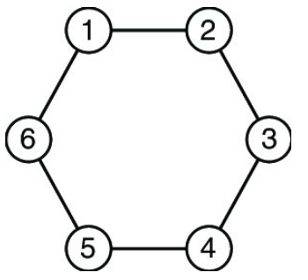
HAMILTON GRAPHS:
:SUFFICIENT CONDITON FOR HAMILTON GRAPH:
DIRAC’S THEOREM : If G is a simple graph with n vertices with n ≥ 3 such that the degree of every vertex in G is at least n/2, then G has a Hamilton circuit.
A
B
C
D
total vertices(n) = 4
Degree of A = 3
Degree of B = 3
Degree of C = 3
Degree of D = 3
Hence it is Hamiltonian.
DIRAC’s Condition does not apply to this graph but this graph is still Hamiltonian.

Slide 11
A connected multigraph with at least two vertices has an Euler circuit if and only if each of its vertices has even degree.
Part 1:
If a connected graph has an Euler circuit, then every vertex must have even degree.
Solution:
To do this, first note that an Euler circuit begins with a vertex a and continues with an edge incident with a, say {a, b}.
The edge {a, b} contributes one to deg(a). Each time the circuit passes through a vertex it contributes two to the vertex’s degree, because the circuit enters via an edge incident with this vertex and leaves via another such edge.
Finally, the circuit terminates where it started, contributing one to deg(a). Therefore, deg(a) must be even, because the circuit contributes one when it begins, one when it ends, and two every time it passes through a (if it ever does).
A vertex other than a has even degree because the circuit contributes two to its degree each time it passes through the vertex.
We conclude that if a connected graph has an Euler circuit, then every vertex must have even degree.

Slide 12
A connected multigraph with at least two vertices has an Euler circuit if and only if each of its vertices has even degree.
Part 2:
(b) If a connected graph has all vertices of even degree then it contains Euler circuit.
Solution:
Construct a closed walk starting at an vertex v and going through the edge of G such that no edge is repeated. Name the closed walk as h.
Case: I If h covers all edges of G, then h becomes an Euler Line and hence G is an Euler graph
Case :II If h doesn’t cover all edges of G then remove all edges of h from G and obtain the remaining grah G’
Every vertex in G’ is also of even degree.
Since G is connected , h will touch G’ at least one vertex v’
Starting from v’ , we again construct a new walk h’ in G’
Now this walk is combined with h forms a closed walk starts and end at v and has more edge than h. This process is repeated until we obtain a closed walk covering all edges og G
Thus G is Eulerian

Slide 13
A connected multigraph has an Euler path but not an Euler circuit if and only if it has exactly two vertices of odd degree and they are starting and ending point.
Part 1:
If a connected graph has an Euler path not circuit, then exactly two vertex must have odd degree.
Solution:
First, suppose that a connected multigraph does have an Euler path from a to b, but not an Euler circuit. The first edge of the path contributes one to the degree of a. A contribution of two to the degree of a is made every time the path passes through a. The last edge in the path contributes one to the degree of b. Every time the path goes through b there is a contribution of two to its degree. Consequently, both a and b have odd degree.
Part 2:
If a connected graph has exactly two vertex must have odd degree, then it has Euler path but not an Euler circuit
Solution:
Suppose that a graph has exactly two vertices of odd degree, say a and b. Consider the larger graph made up of the original graph with the addition of an edge {a, b}. Every vertex of this larger graph has even degree, so there is an Euler circuit. The removal of the new edge produces an Euler path in the original graph.

